Slide 1

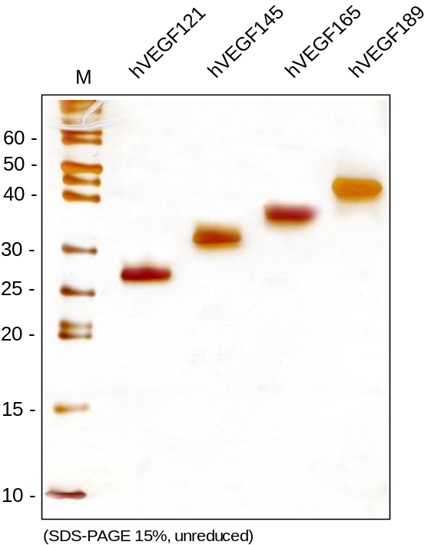
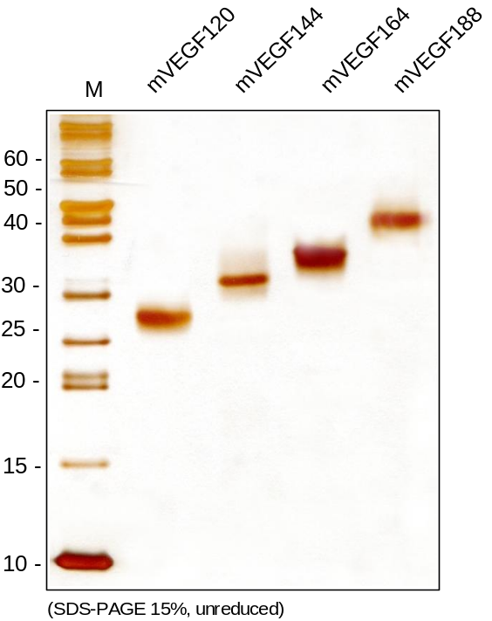
ReliaTech GmbH
Recombinant human and mouse VEGF-A isoforms (E. coli)
(Human: Cat #300-0071/-033/-75/-094; Mouse: Cat#M30-031/-033/-003/-094)
Figure 1: SDS-PAGE analysis of recombinant human and mouse VEGF-A isoforms produced in E. coli. Sample was loaded under non-reducing conditions in 15% SDS-polyacrylamide gel and stained with Coomassie stain.
http://www.reliatech.de / orders@reliatech.de

